Slide 1
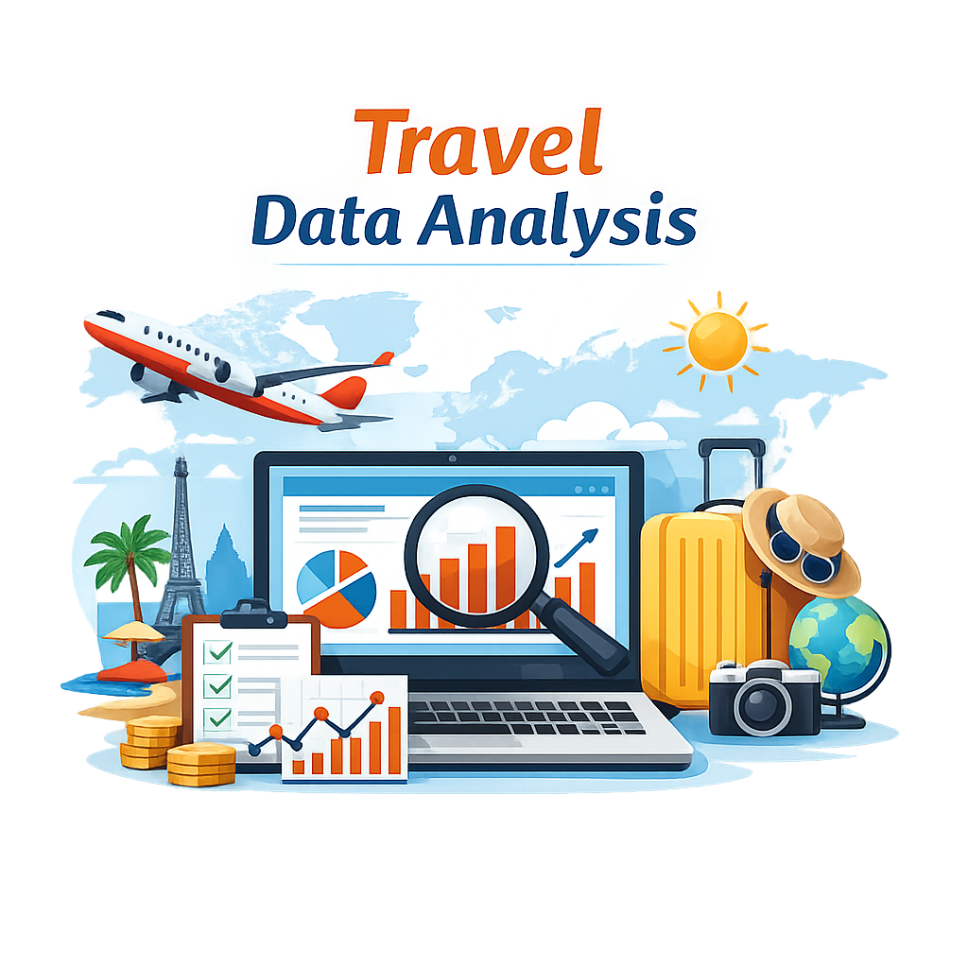
travel agency
Smart Travel Analytics

Slide 2
Team Members:
Ahmed Hussein Afifi (Excel)
Islam Adel Ali (Excel)
Esraa Khaled Ragab (Power BI)
Nesma Wael Amer (Python)
Diana Emad Wagdy (SQL)
Mahmoud Tarek Ali (SQL)

Slide 3
Problem Statement
Travel agencies collect large amounts of customer and booking data every day, but this data is often underutilized. Without proper analysis, it becomes difficult to identify popular destinations, understand customer preferences, and improve business performance.
This project aims to analyze travel agency data to discover useful insights, identify booking trends, and support better business decisions through data visualization and analytics.

Slide 4
Project Objectives
Analyze customer booking behavior
Identify the most popular travel destinations
Discover seasonal travel trends
Evaluate customer satisfaction levels
Analyze agency revenue and booking performance
Provide data-driven recommendations for business improvement
Create interactive visualizations and dashboards for better decision-making

Slide 5
Dataset Overview
DimVisaApplications Contains information about customer visa applications, approval status, processing time, and destination countries.
DimHotels Includes hotel details such as hotel names, locations, ratings, room types, and pricing information.
DimTickets Stores ticket-related data including airline information, ticket class, departure dates, and ticket prices.
FactBookings The main transactional table that contains booking records, customer activities, travel costs, booking dates, and links between all dimensions.
Purpose of the Dataset
The dataset was analyzed to:
Understand customer booking behavior
Identify popular destinations and hotels
Analyze travel and ticket trends
Measure booking performance and revenue
Generate business insights for better decision-making in the travel agency sector

Slide 6
Data Cleaning
Before starting the analysis, the dataset was cleaned and prepared to ensure accuracy and consistency of the results.
Data Cleaning Steps
Removed missing and null values
Eliminated duplicate records
Standardized date and text formats
Corrected inconsistent data entries
Checked relationships between dimension tables and the fact table
Verified hotel, ticket, and visa data integrity
Prepared the dataset for analysis and visualization
These steps helped improve data quality and ensured reliable insights throughout the project.

Slide 7
Tools & Technologies
SQL Used for querying, managing, and extracting data from the database.
Python Used for data cleaning, preprocessing, and exploratory data analysis (EDA).
Power BI Used to create interactive dashboards and data visualizations.
Excel Used for initial data inspection, organization, and simple analysis tasks.

Slide 8
Conclusion
Data analysis helps travel agencies make smarter and more profitable decisions.

Slide 9
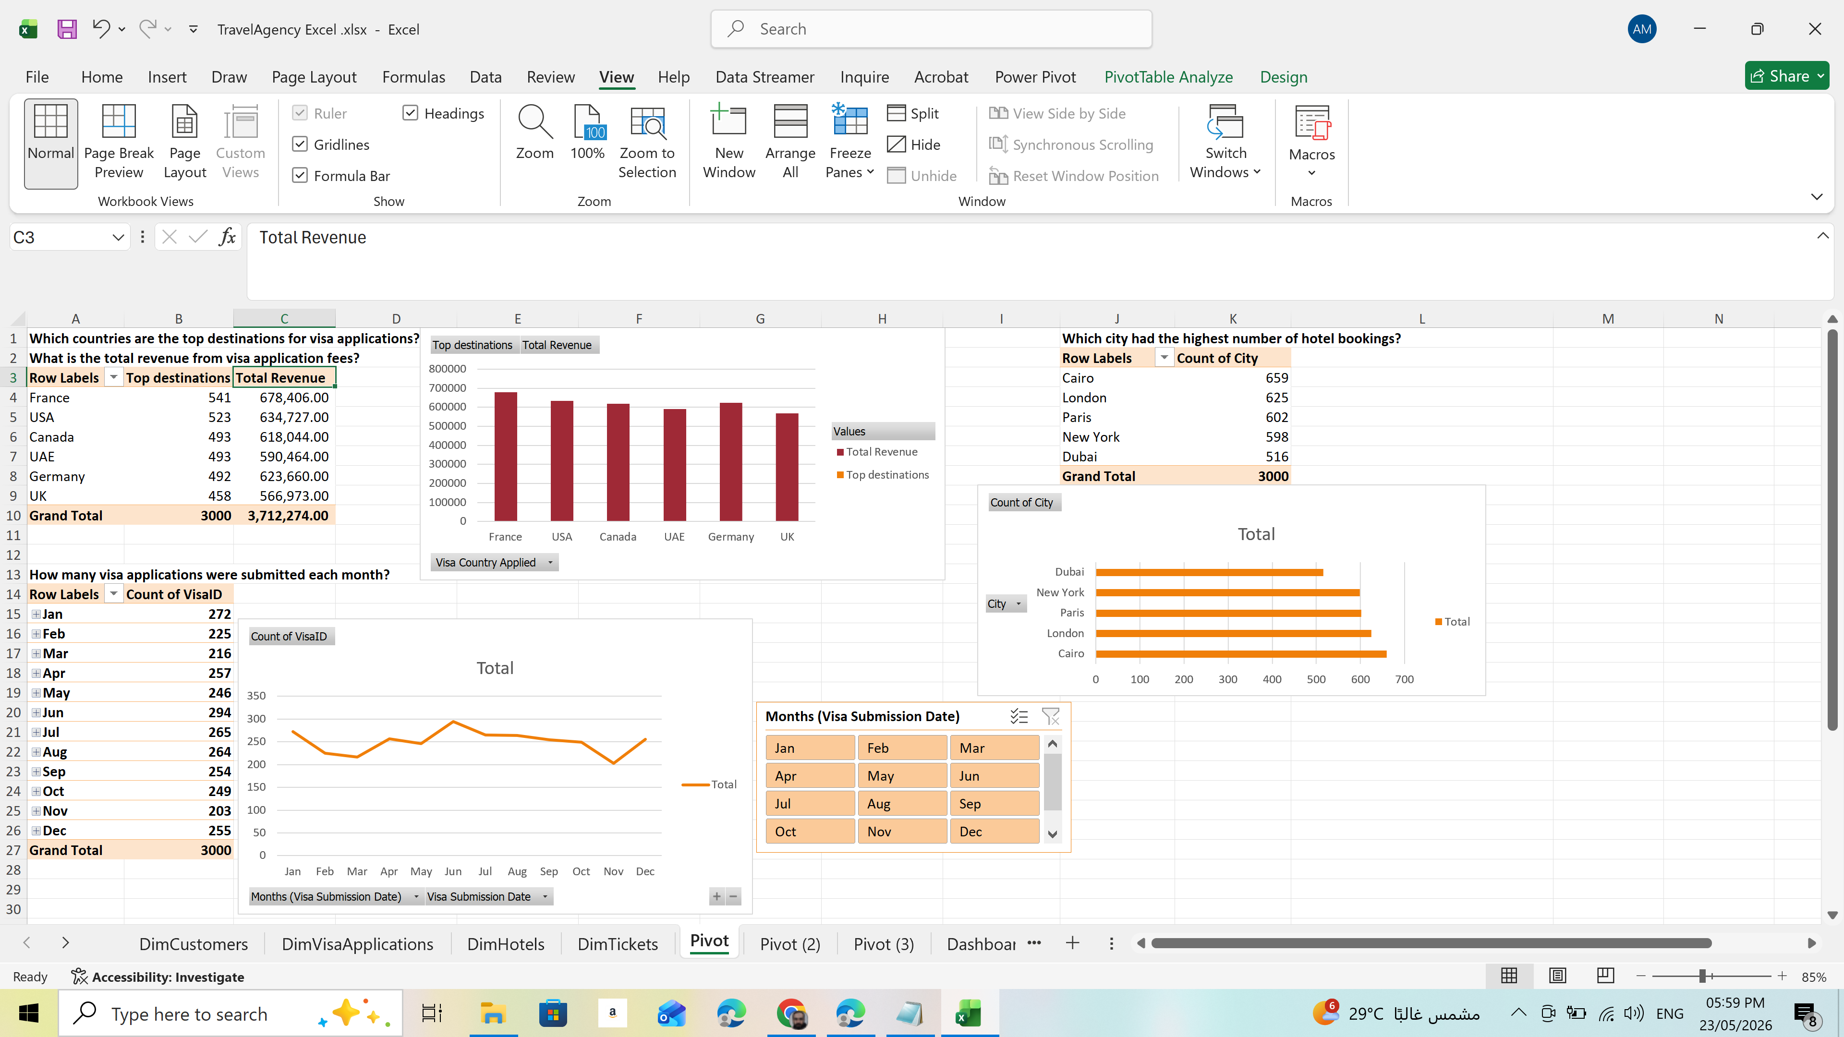
excel

Slide 10
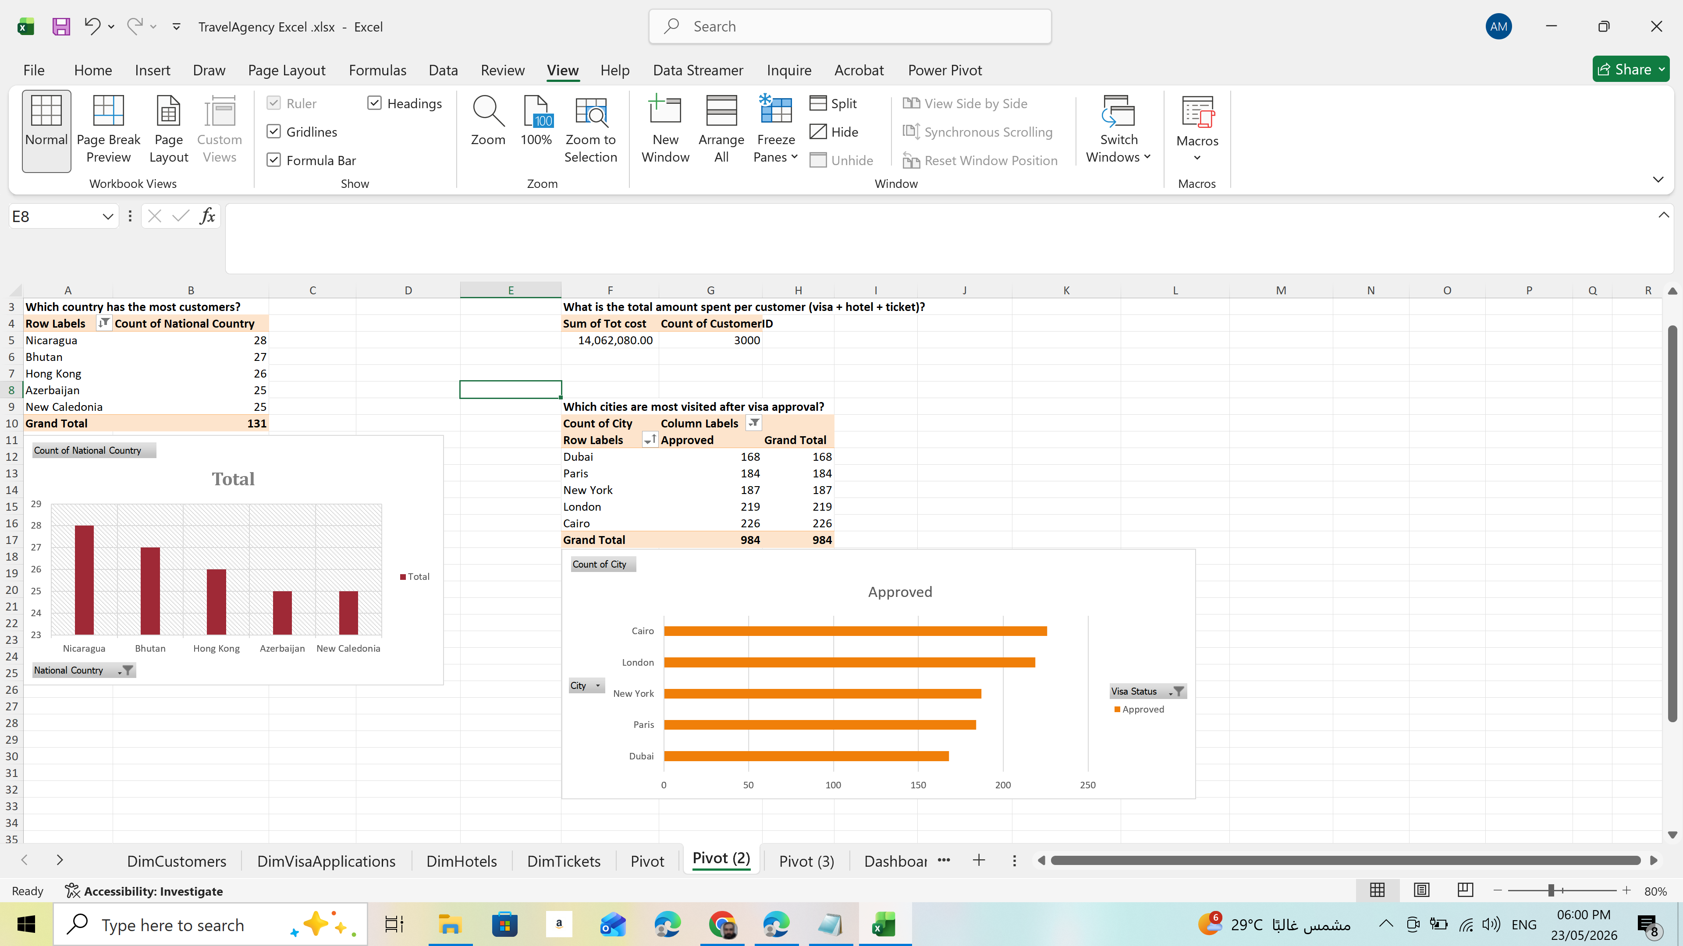
Excel

Slide 11
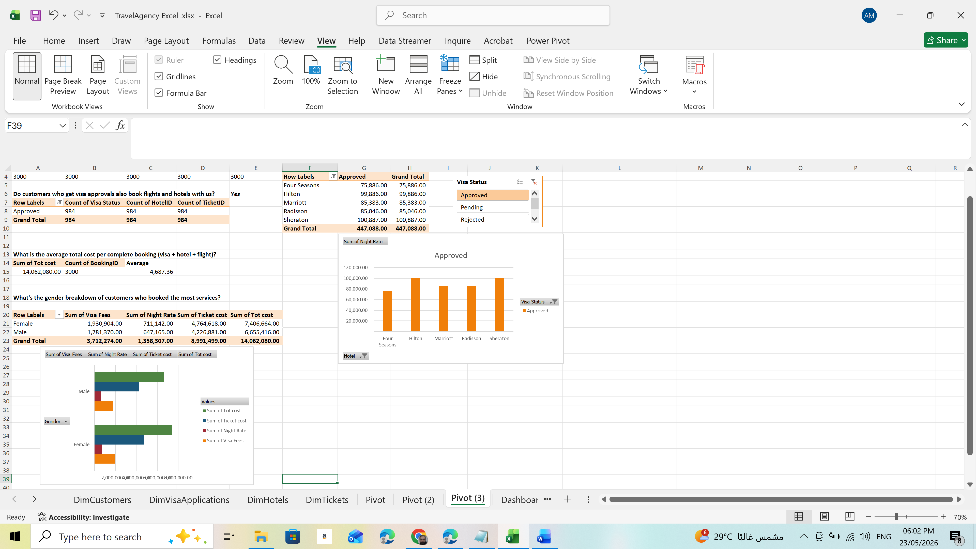
Excel

Slide 12
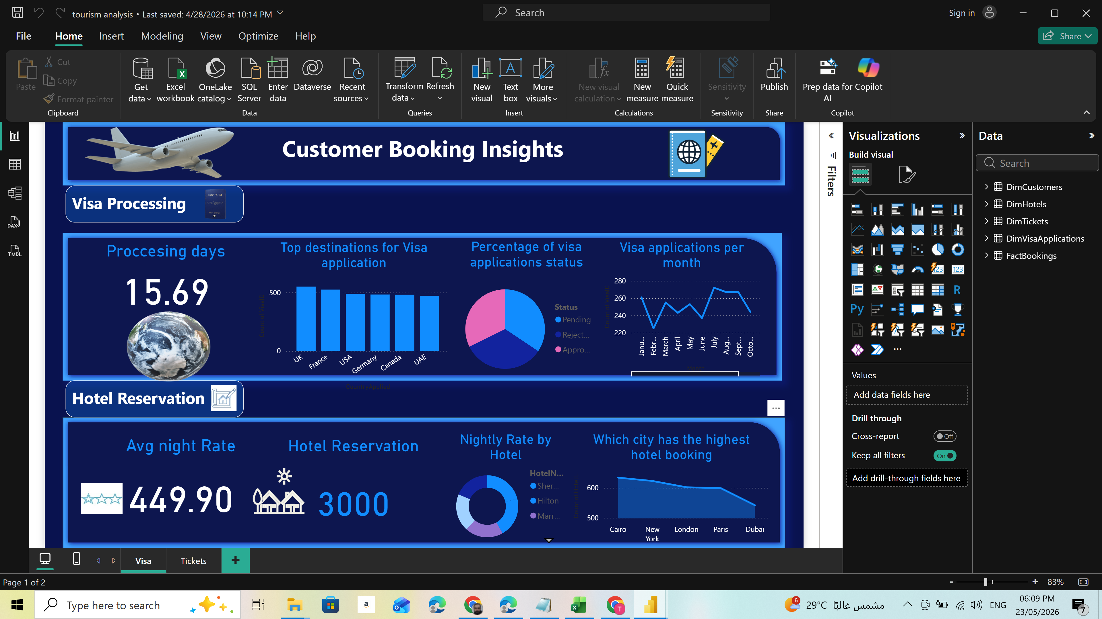
Power BI

Slide 13
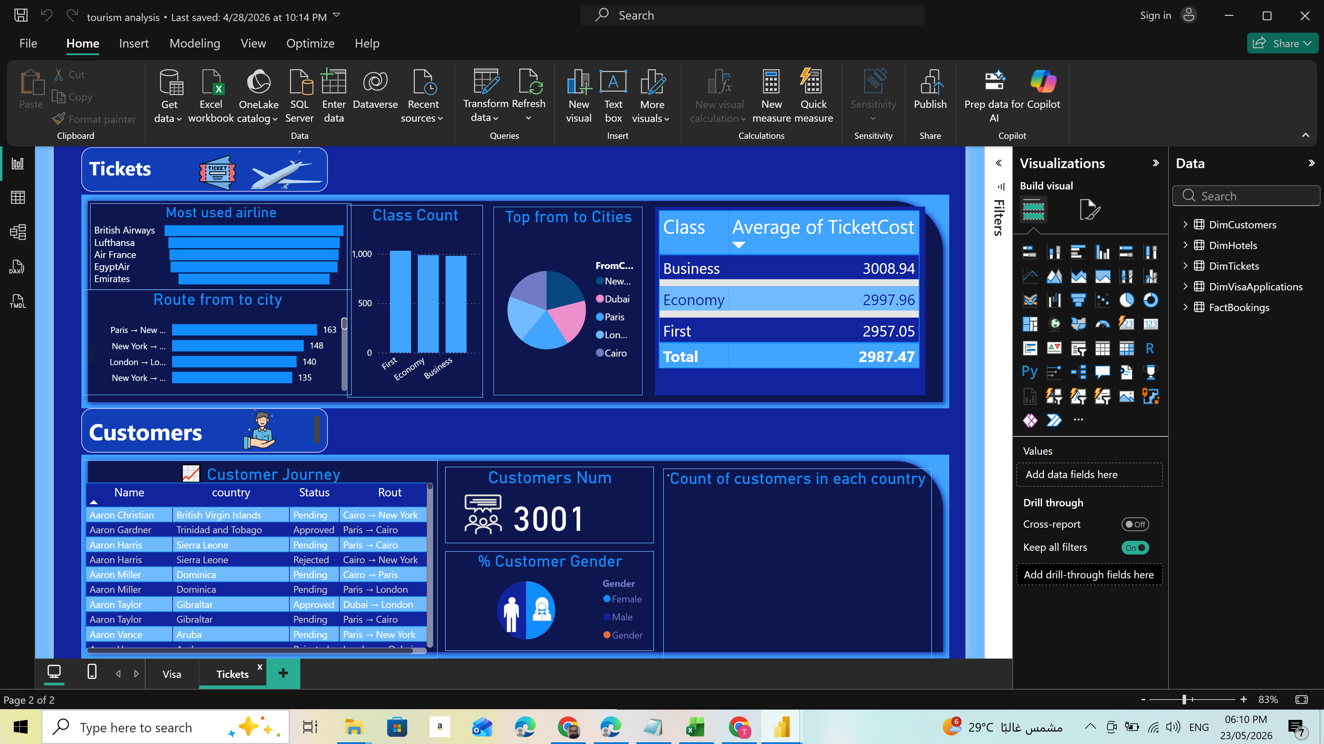
Power BI

Slide 14
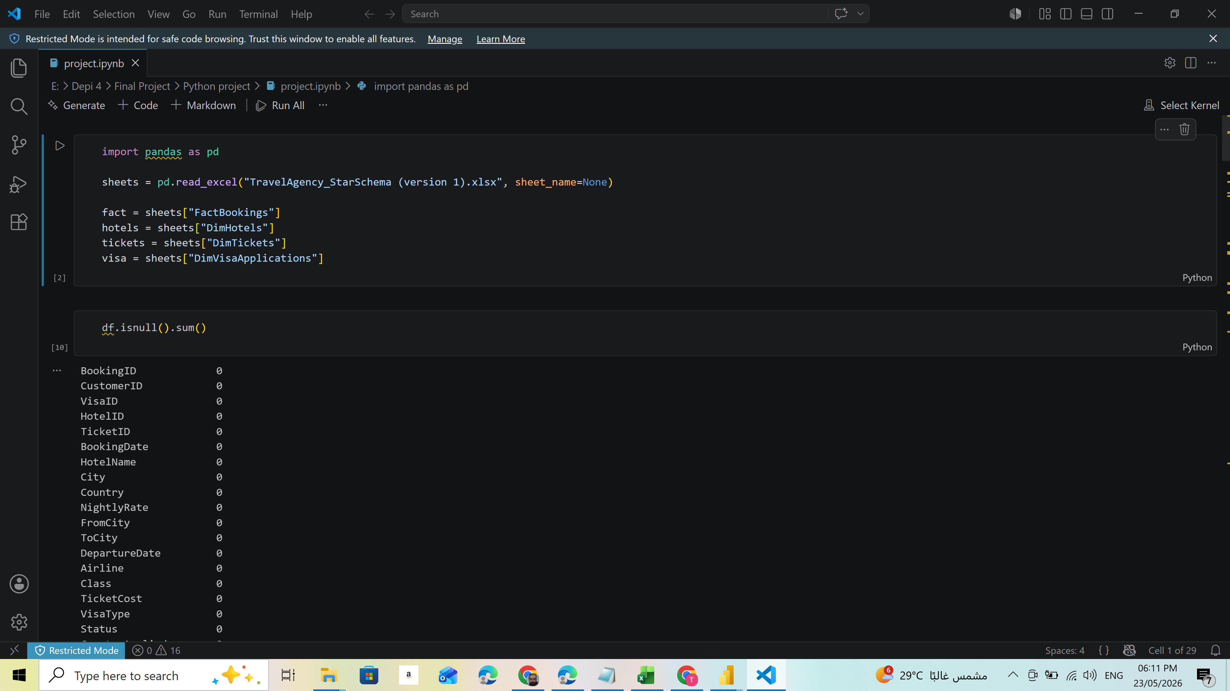
Python

Slide 15
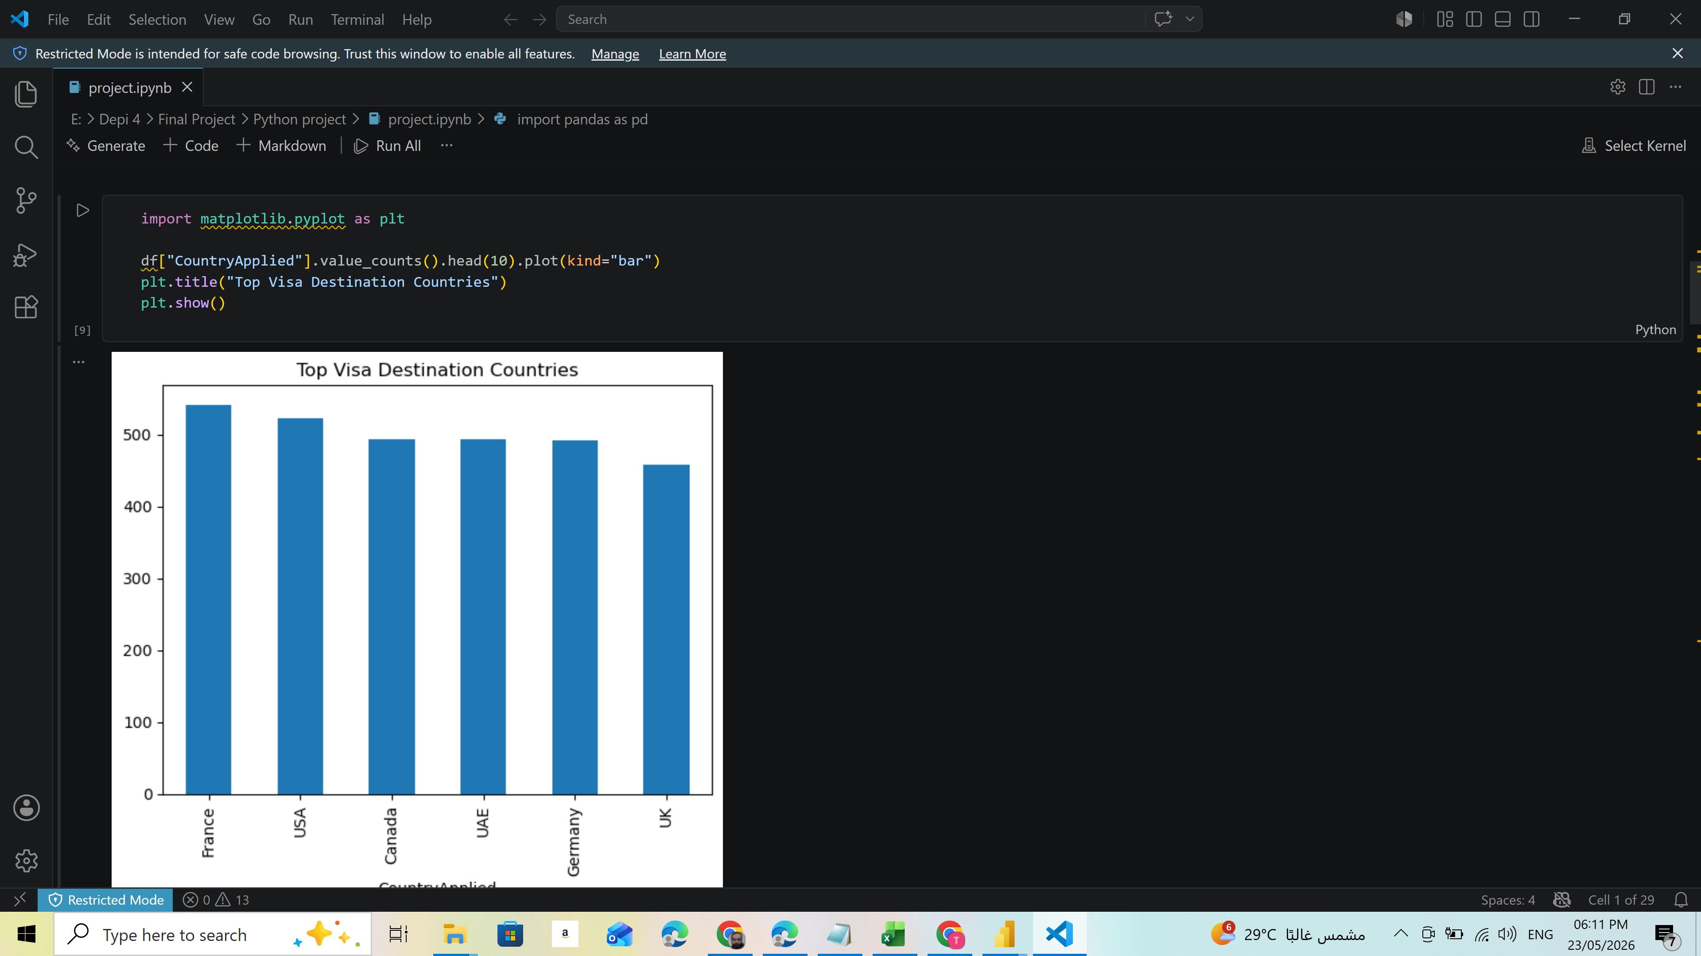
Python

Slide 16
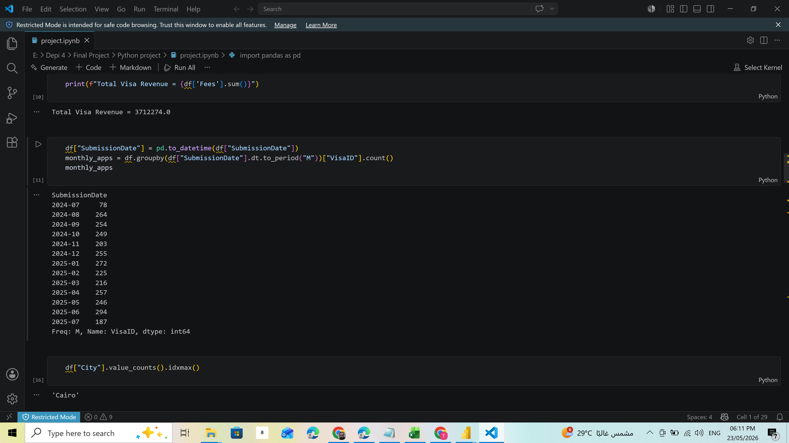
Python

Slide 17
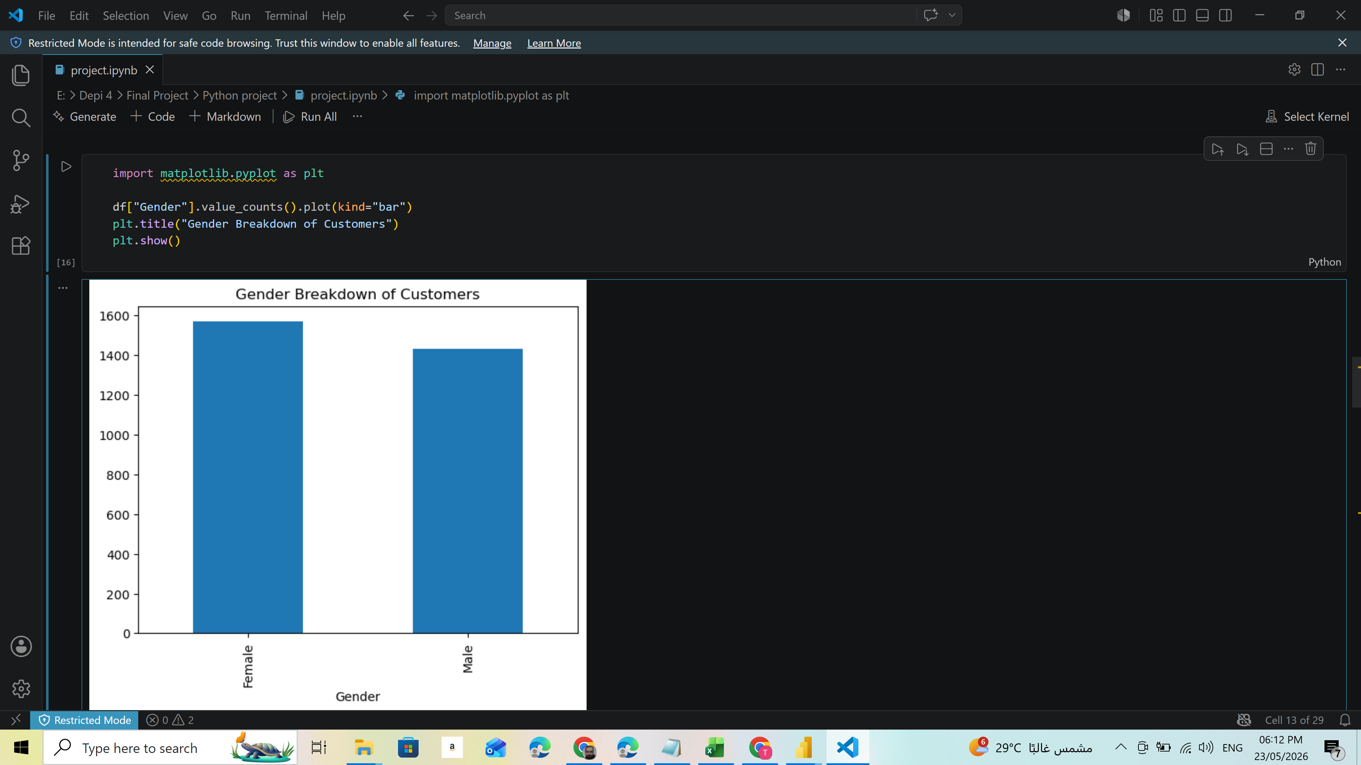
Python

Slide 18
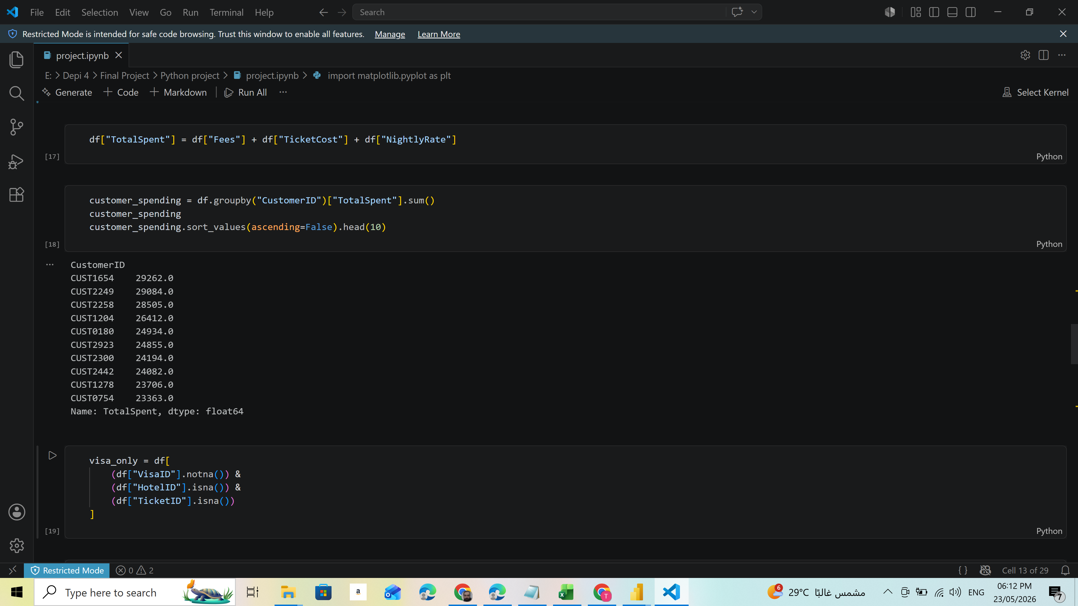
Python

Slide 19
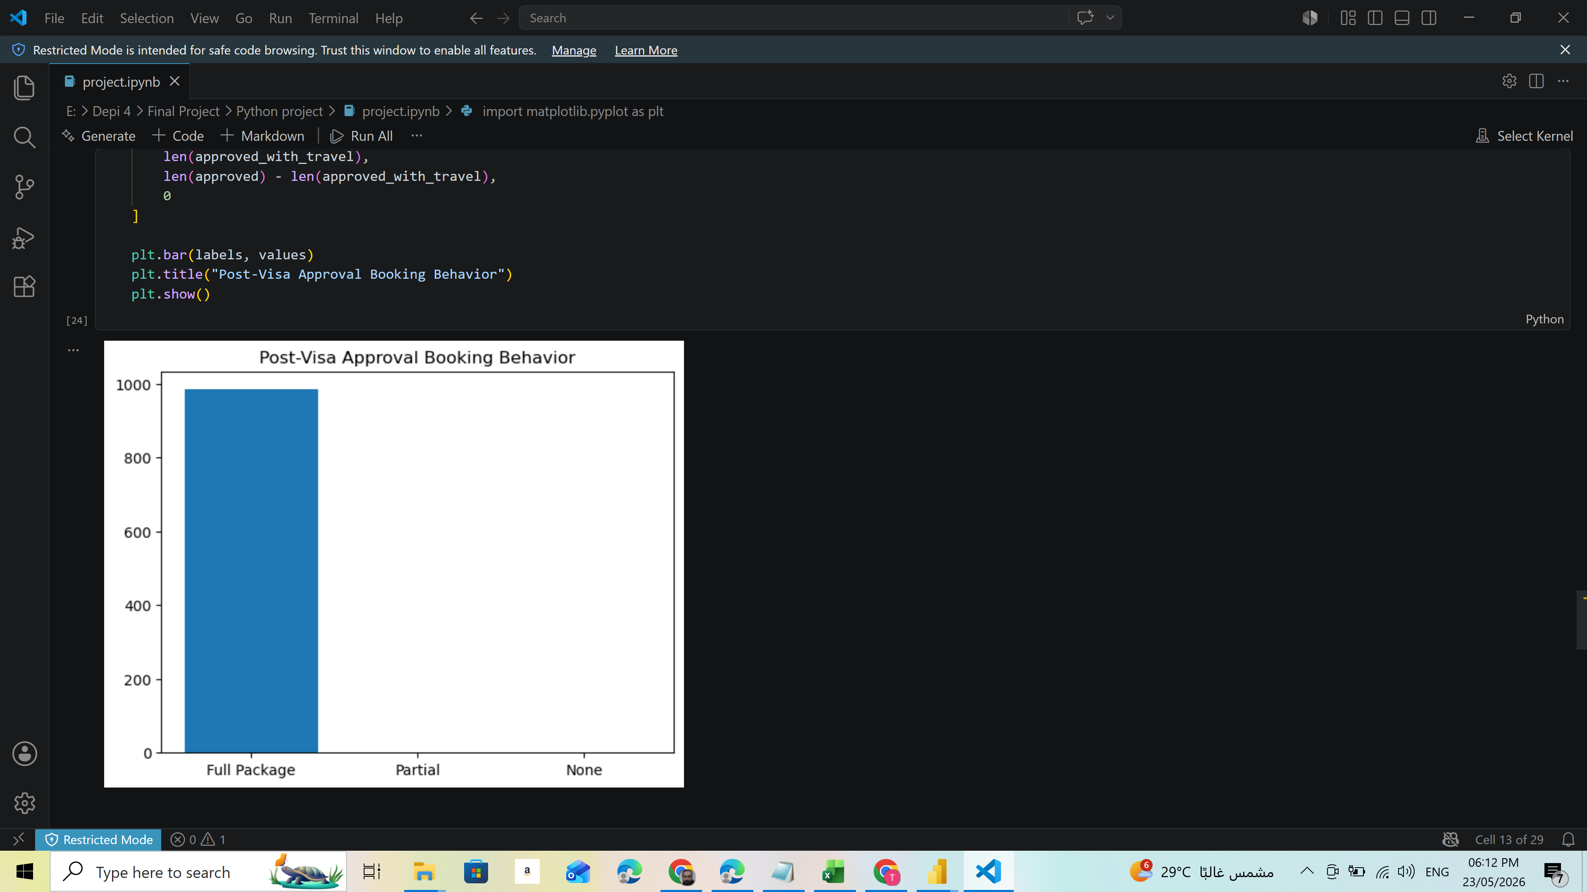
Python

Slide 20
Thank you

